Slide 1
Face recognition using python

Slide 2
What is face recognition
Face detection and Face Recognition are often used interchangeably but these are quite different. In fact, Face detection is just part of Face Recognition.
Face recognition is a method of identifying or verifying the identity of an individual using their face. There are various algorithms that can do face recognition but their accuracy might vary. Here we are going to learn Face Recognition using Face Recognition Module

Slide 3
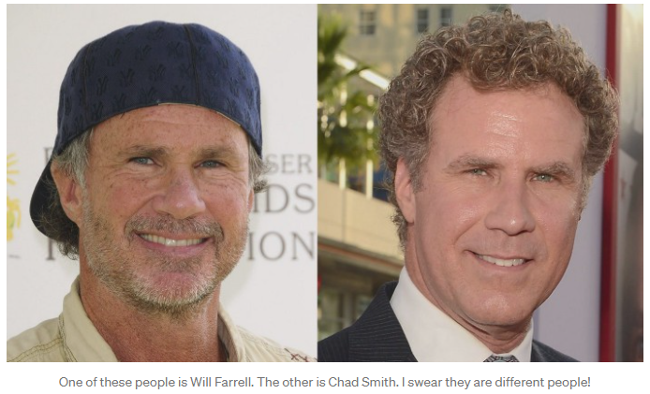
Performance?
But just recognizing your friends would be too easy. We can push this tech to the limit to solve a more challenging problem — telling Will Ferrell (famous actor) apart from Chad Smith (famous rock musician)!

Slide 5
What an algorithm needs to do?
First, look at a picture and find all the faces in it
Second, focus on each face and be able to understand that even if a face is turned in a weird direction or in bad lighting, it is still the same person.
Third, be able to pick out unique features of the face that you can use to tell it apart from other people— like how big the eyes are, how long the face is, etc
Finally, compare the unique features of that face to all the people you already know to determine the person’s name.

Slide 6
Methodology

